Slide 1
Between a Rock and a Hard place: Sonar classification Project
By Tolly Vellis

Slide 2
Table of Contents
Introduction to project
Process
Results
Conclusion

Slide 3
Introduction to Project

Slide 4
Background
The “Sonar, Mines vs. Rocks” dataset is populated by a series of numbers representing signals returned from bouncing sonar chirps off metal cylinders and rocks at various angles and conditions in the ocean.
It was intended to provide better data for detecting the existence of mines in deep water.
This is a binary classification problem: the object is either a rock or a metal cylinder.

Slide 5
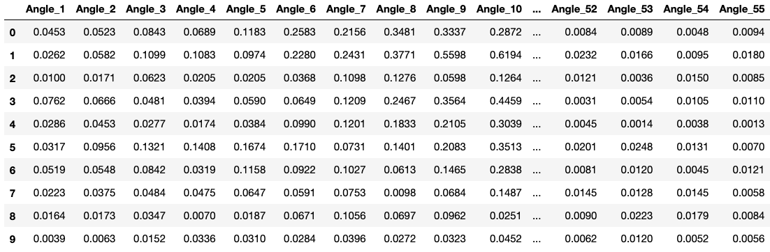
Parameters
The dataset has 111 mines (“M”) and 97 rocks (“R”). There are 208 rows total, excluding the header; thus, accuracy will be a reasonable metric for scoring.
There are 60 features in the dataset, made up of values ranging from about about 0 – 1.
Success will be in accurately determine whether a sample is a rock or mine based off the values given in the 60 provided features.

Slide 6
Process

Slide 7
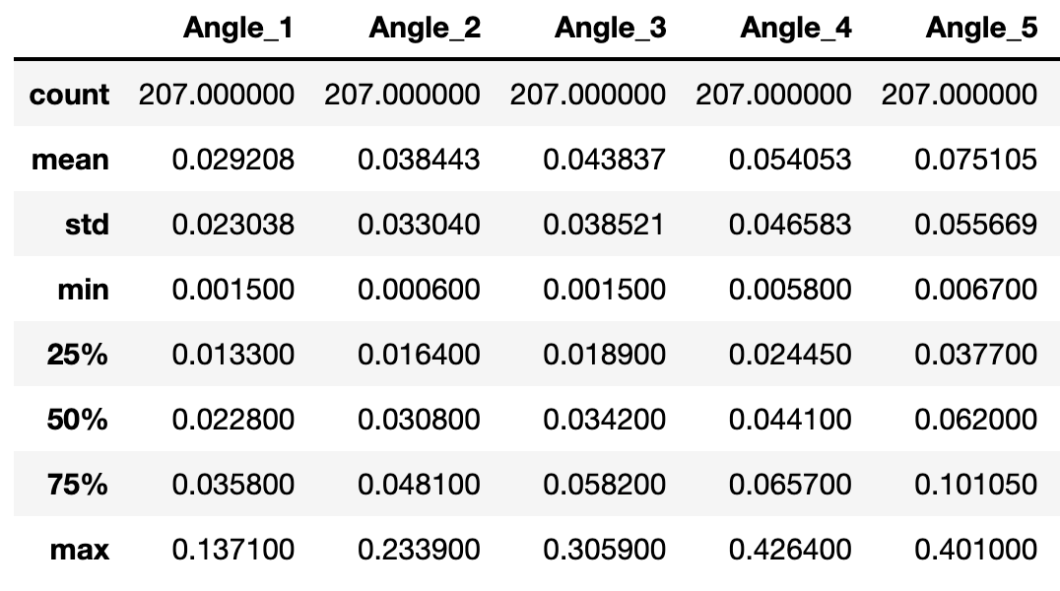
Data exploration
Initial review of data was conducted.
It was found that there were no null values, a reasonable variation between min/max values of the different angles, and approximate parity between the number of each result (“R” vs “M”)

Slide 8
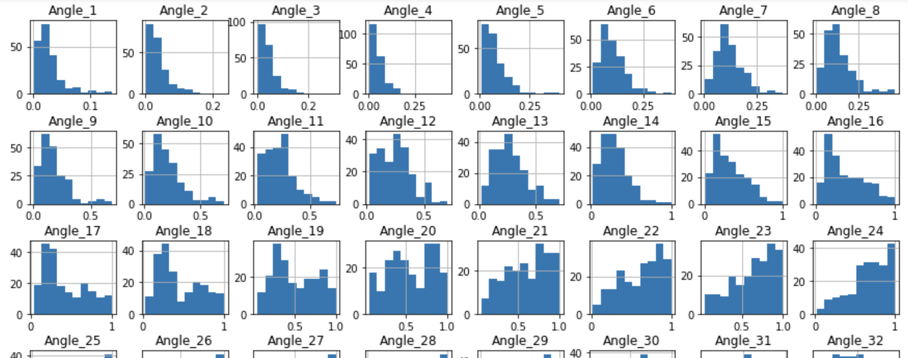
Charting and skewness
Plotting of histograms for each feature showed that, though some of them displayed gaussian distributions, the samples overall were typically right skewed (see picture below)
Average skewness was 0.97. This suggested that standardization or transformation of the data might be of value during the data wrangling phase.

Slide 9
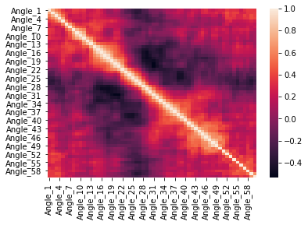
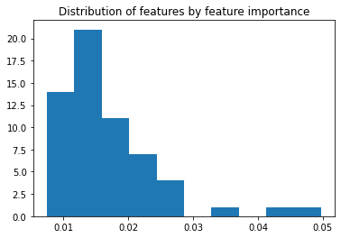
Correlation and key features
Heatmap of correlations suggested that similar angles might be highly correlated with one another. (e.g. angle 1 with angle 2, angle 7 with angle 8, etc.)
Conversely, a review of feature importance using an ExtraTreeClassifer model shows that most features offer similar levels of contribution to the final result, with some outliers.
This suggests there might be value in thinning features later.

Slide 10
Algorithms chosen and testing
Taking an empirical approach, I selected a handful of different classification models, including some ensemble style ones.
These included Logistic Regression, SVC and decision trees.
The results “M”/”R” were reclassified as 1/0 to ensure consistency in the use of qualitative values in the dataset.
K_fold with 10 splits was taken to get a reasonable distribution of tests.
Accuracy was the metric tested for.

Slide 11
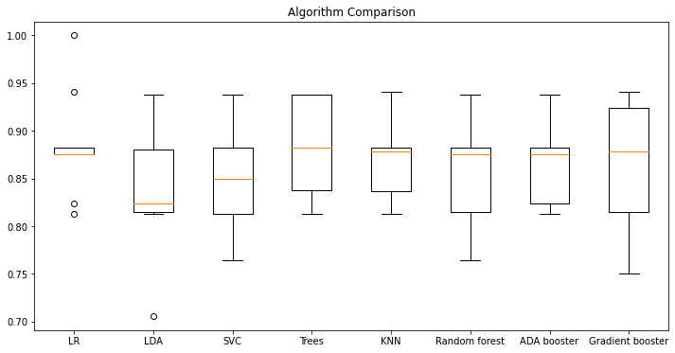
Algorithms testing #1
A first pass with untransformed data was taken. Most algorithms accomplished results of around 87%.
Trees (CART) showed slightly superior results, but some of these algorithm’s results (like LogisticRegression) were likely hurt by unstandardized data.

Slide 12
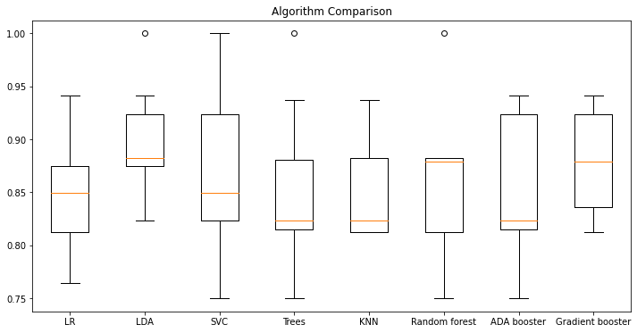
Algorithms testing #2
A second pass with standardized data was taken. This resulted in more diversity of algorithm outputs.
It did not appear that standardizing the data had that much of an impact in pulling any algorithm ahead of any other one.

Slide 13
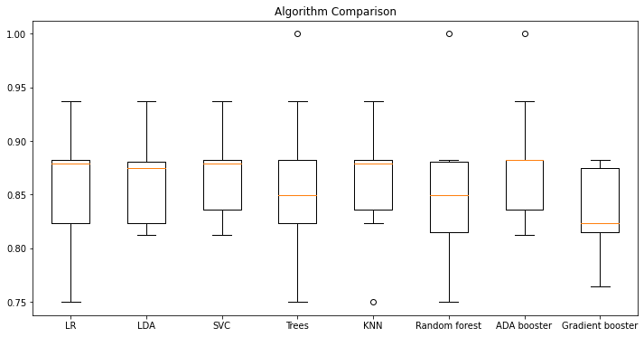
Algorithms testing #3
A third pass with the data transformed by taking the square root (to account for the right skewness) of all X values was performed.
This seemed to result in in more stable results, especially with SVC.

Slide 14
Additional tests
I also tried thinning the dataset by removing every second column, since there was shown to be correlation between features close to one another, but no improvement to accuracy was seen.
Similarly, I tried transforming the data with a little more nuance by taking a conditional based on the skewness: >0.5 was (^1/2), <-0.5 was (^2). This did not, however, have as positive an impact as simply transforming all x-values by taking the square root, so for the final phase I took the conditions established in ”Algorithms testing #3”

Slide 15
Results

Slide 16
Model tuning
Based off the explorations from before it was decided that SVC would be the best model to tune.
GridSearchCV was used, running many different values on C, gamma and kernel.
It was determined that C = 1, gamma = 2.5 and kernel = ‘rbf’ gave superior results.

Slide 17
Model results
A final run of SVC with optimized parameters was performed on the retained test set.
Results were good: average of 91% with over half the runs landing around ~94%.
Precision, recall and F1_score were also around 88-90% on average.

Slide 18
Conclusion

Slide 19
Comparison to existing results
A quick review of other’s attempts at the project on Kaggle* showed that results of around 83-86% were common.
My result of 91% is therefore a very strong showing.
It seems likely that transforming the data to normalize the distributions, in combination with successful tuning, made the difference with accuracy here.
https://www.kaggle.com/sugamkhetrapal/project-3-sonar-mines-vs-rocks
https://www.kaggle.com/mattcarter865/sonar-mines-vs-rocks
https://www.kaggle.com/vgadevik/sonar-mine-vs-rock-tensorflow

Slide 20
Discussion
This relatively small-scale project allowed a good review of many of the fundamentals of running a classification model.
This includes:
Data exploration
Data transformation
Model testing and comparison
This will be good practice for future projects. Next, it might be worthwhile looking at larger datasets with less clean data.

